Slide 1


Green Pace
Security Policy Presentation
Developer: Felicia Schenkelberg

Slide 2

OVERVIEW: DEFENSE IN DEPTH

Slide 3
THREATS MATRIX
Likely STD-002-CPP STD-004-CPP STD-006-CPP STD-008-CPP STD-009-CPP STD-010-CPP | Priority STD-002-CPP STD-004-CPP STD-005-CPP STD-006-CPP STD-008-CPP STD-009-CPP STD-010-CPP
Low priority STD-001-CPP STD-003-CPP STD-007-CPP | Unlikely STD-001-CPP. STD-003-CPP STD-005-CPP STD-007-CPP

Slide 4
10 PRINCIPLES
“Validate Input Data.
Heed compiler warnings.
Architect and design for security policies.
Keep it simple.
Default deny.
Adhere to the principle of least privilege.
Sanitize data sent to other systems.
Practice defense in depth.
Use effective quality assurance techniques.
Adopt a secure coding standard” (Seacord, 2018).

Slide 5
CODING STANDARDS
Create and use abstract data types.
Ensure that integer conversions do not result in lost or misinterpreted data.
Reset strings on fgets() failure.
Sanitize data passed to complex subsystems.
Do not assume memory allocation routines initialize memory.
Prefer functions that do not rely on file names for identification.
Use feof() and ferror() to detect end-of-file and file errors.
Include a mutex when using bit-fields in a multi-threaded Environment.
Allocate and free memory in the same module, at the same level of Abstraction.
Understand integer conversion rules.

Slide 6
ENCRYPTION POLICIES
The policies for encryption in flight, at rest, and in use.

Slide 7
TRIPLE-A POLICIES
Triple-A Framework* | Explain what it is and how and why the policy applies.
Authentication | Authentication provides a method of identifying a user.
Authorization | Authorization provides a method of allowing user to complete certain tasks.
Accounting | Accounting provides a method of monitoring the resources used during a user’s network access.

Slide 8
Unit Testing
Development teams need to consider the concept of secure design when developing applications. When coding any software, the main goal is to focus on security. Never leave protection and security until the end of development. It is important to note that any errors associated with this can damage the entire software. Unit Testing is a process used to verify that each coding unit is working properly. This test confirms the status of the program at a given execution point.

Slide 9

AUTOMATION SUMMARY

Slide 10
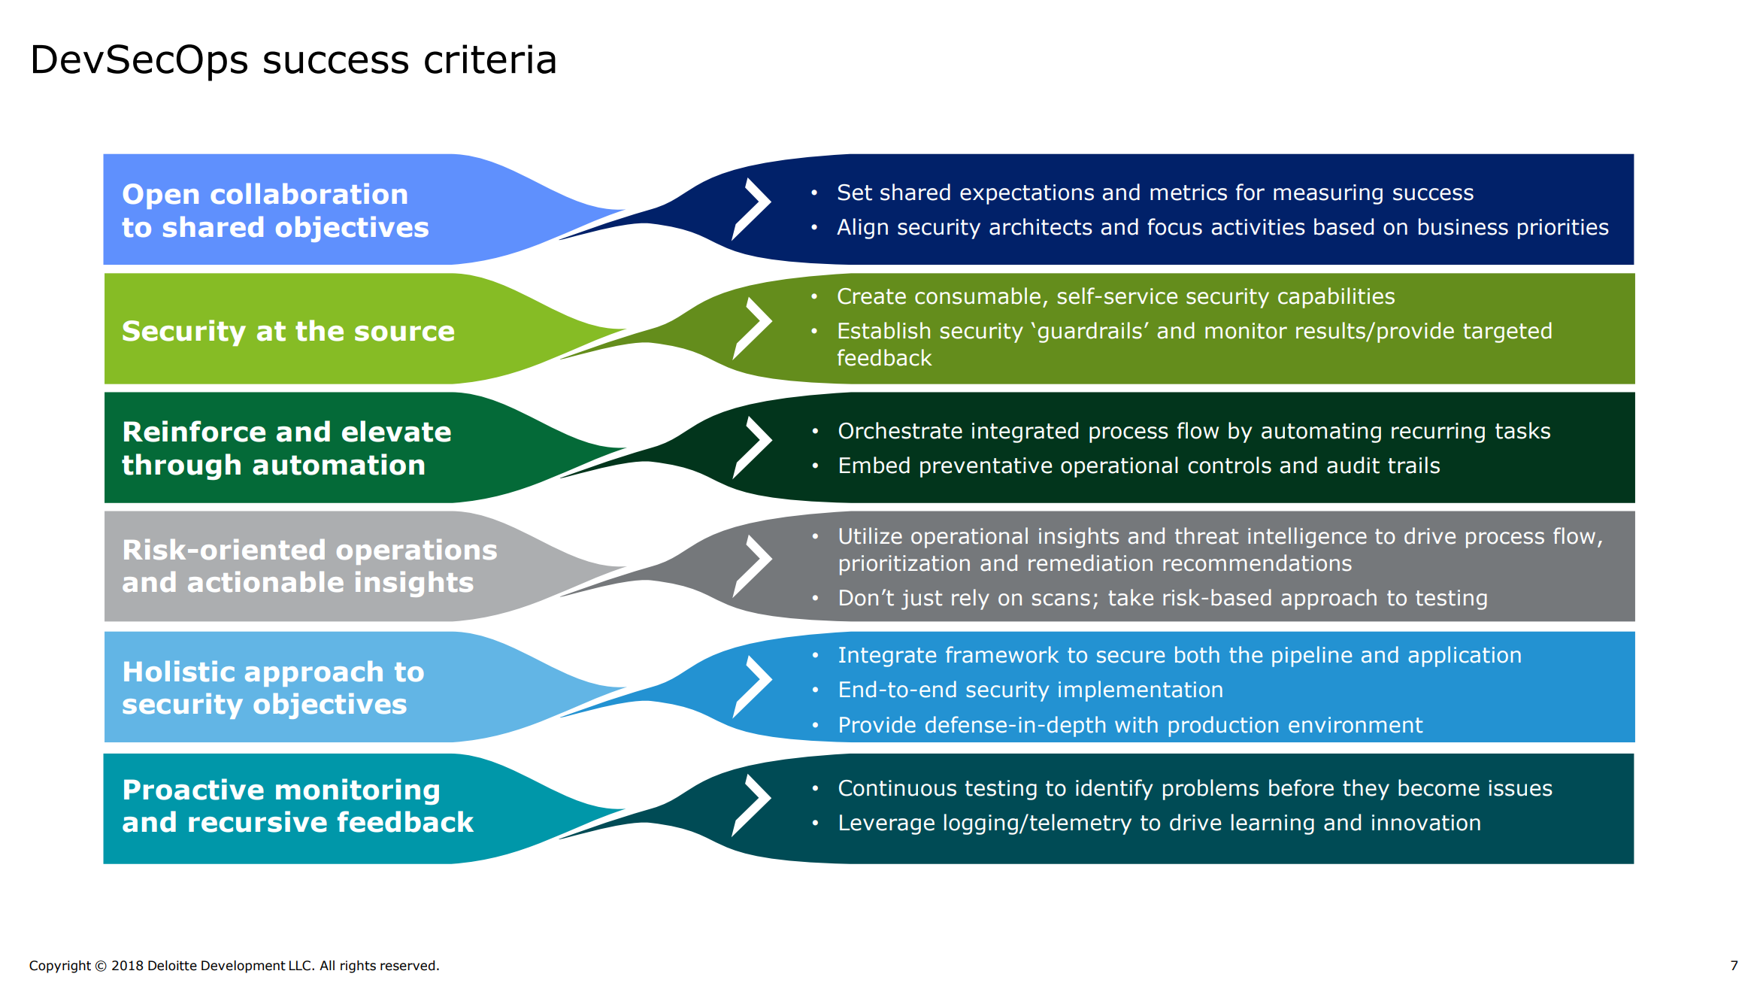
TOOLS

Slide 11
RISKS AND BENEFITS
Threat and risk modeling procedures identify potential risks to the system. In this way, threat levels are reduced or even blocked. For example, sensitive data might be cached by proxies. As a principle, limit the information sent to what is necessary to mitigate risks. A real-world example is illustrated in Coding Standard 4.

Slide 12
RECOMMENDATIONS
Audit Controls and Management
Enforcement

Slide 13
Conclusion
Exceptions Process

Slide 14
REFERENCES
Carnegie Mellon University. (2007, September 10). CERT C Programming Language Secure Coding Standard. Confluence. http://www.open-std.org/jtc1/sc22/wg14/www/docs/n1255.pdf
Seacord, R. (2018, May 2). Top 10 Secure Coding Practices. Confluence. https://wiki.sei.cmu.edu/confluence/display/seccode/Top+10+Secure+Coding+Practices

